Slide 1
Eigenvalue problem numerically

Slide 2

Simple eigenvalue problem
$$y"=λy$$
$$y\left(0\right)=y\left(1\right)=0$$
Analytic solution:
$$λ_{n}=\frac{n^{2}π^{2}}{L^{2}}$$
With associated eigenfunctions
$$y_{n}=\sin\left(\frac{nπx}{L}\right), n=1,2,3,…$$

Slide 3

Numerical scheme
$$y"=λy$$
$$y\left(0\right)=y\left(1\right)=0$$
Finite difference:
$$\frac{y_{i−1}+2y_{i}+y_{i+1}}{{\left(Δx\right)}^{2}}=λ_{Δx}y_{i}$$
Where $Δx=\frac{1}{n+1}$.

Slide 4
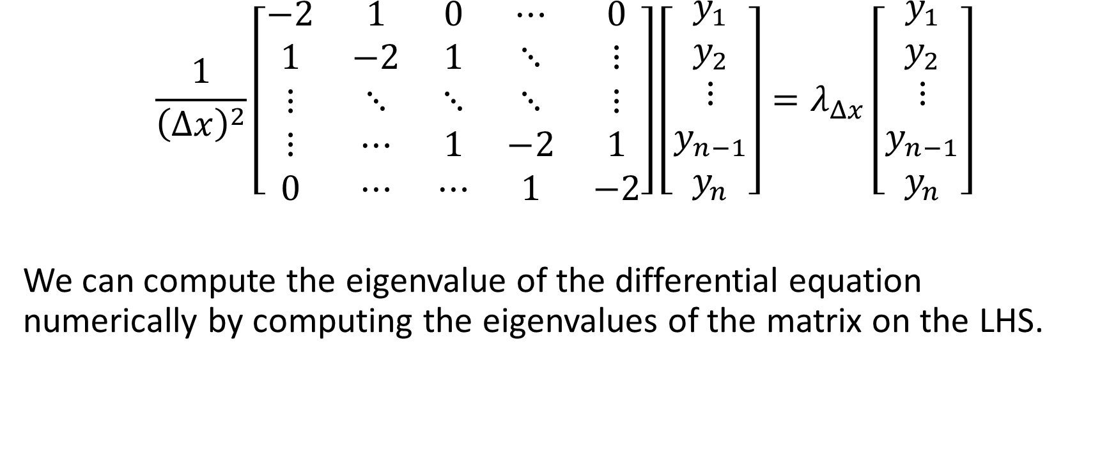
Convert to matrix
$$\frac{1}{{\left(Δx\right)}^{2}}\left[\begin{matrix}−2 & 1 & 0 & ⋯ & 0 \\ 1 & −2 & 1 & ⋱ & ⋮ \\ ⋮ & ⋱ & ⋱ & ⋱ & ⋮ \\ ⋮ & ⋯ & 1 & −2 & 1 \\ 0 & ⋯ & ⋯ & 1 & −2\end{matrix}\right]\left[\begin{matrix}y_{1} \\ y_{2} \\ ⋮ \\ y_{n−1} \\ y_{n}\end{matrix}\right]=λ_{Δx}\left[\begin{matrix}y_{1} \\ y_{2} \\ ⋮ \\ y_{n−1} \\ y_{n}\end{matrix}\right]$$
We can compute the eigenvalue of the differential equation numerically by computing the eigenvalues of the matrix on the LHS.

Slide 5
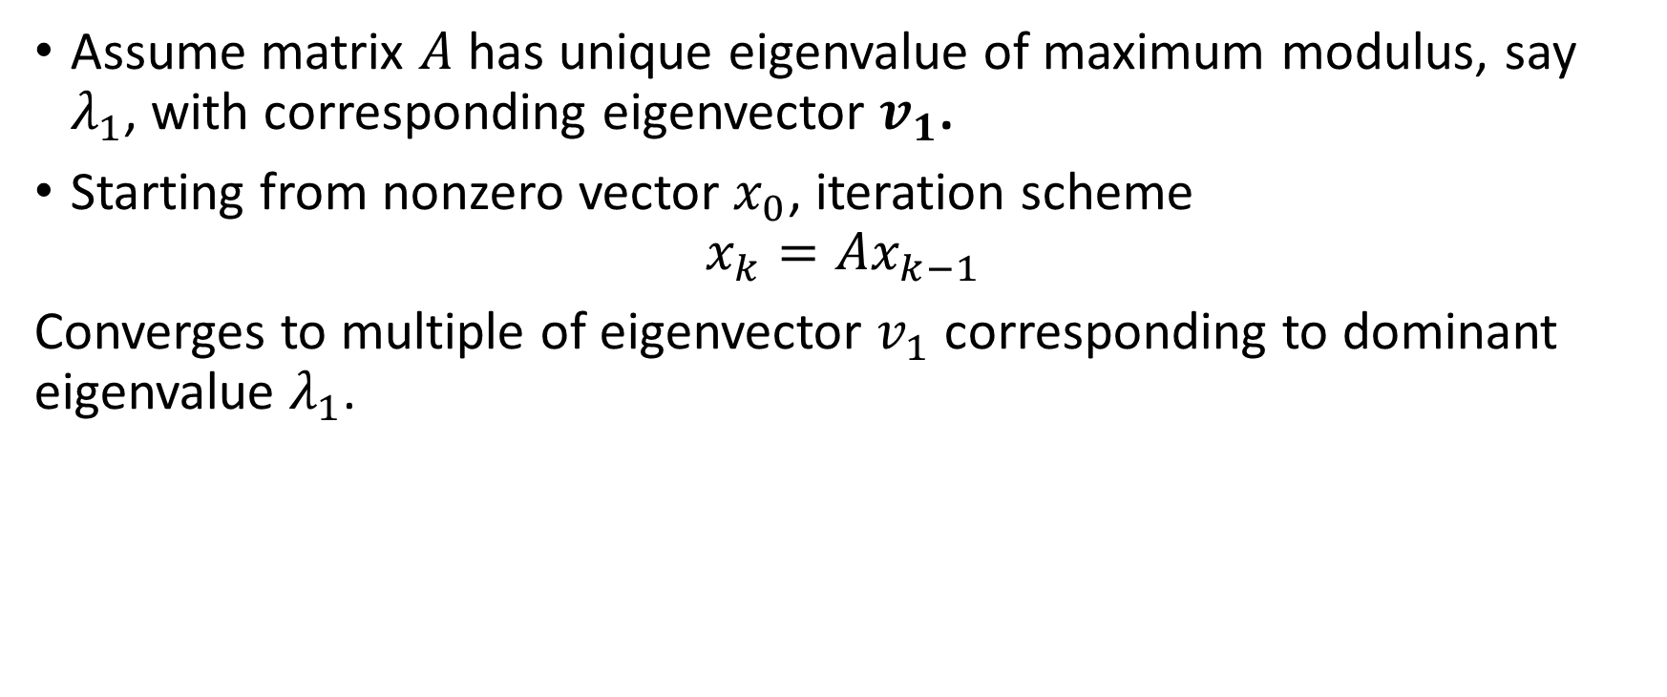
Power Method
Assume matrix $A$ has unique eigenvalue of maximum modulus, say $λ_{1}$, with corresponding eigenvector $v_{1}$.
Starting from nonzero vector $x_{0}$, iteration scheme
$$x_{k}=Ax_{k−1}$$
Converges to multiple of eigenvector $v_{1}$ corresponding to dominant eigenvalue $λ_{1}$.

Slide 6
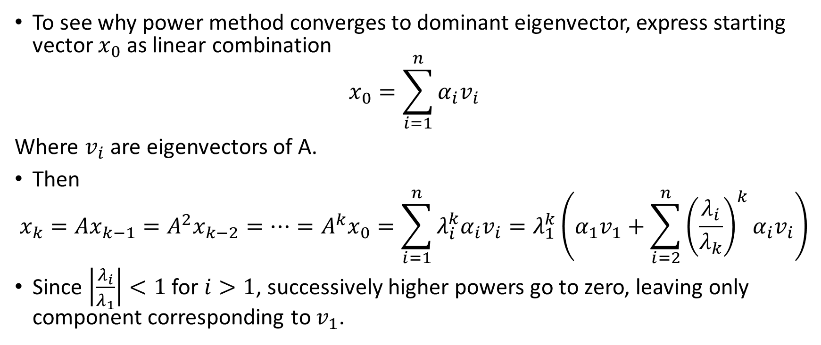
Convergence of Power Method
To see why power method converges to dominant eigenvector, express starting vector $x_{0}$ as linear combination
$$x_{0}=\sum_{i=1}^{n}{α_{i}v_{i}}$$
Where $v_{i}$ are eigenvectors of A.
Then
$$x_{k}=Ax_{k−1}=A^{2}x_{k−2}=…=A^{k}x_{0}=\sum_{i=1}^{n}{λ_{i}^{k}α_{i}v_{i}}=λ_{1}^{k}\left(α_{1}v_{1}+\sum_{i=2}^{n}{{\left(\frac{λ_{i}}{λ_{k}}\right)}^{k}α_{i}v_{i}}\right)$$
Since $\left|\frac{λ_{i}}{λ_{1}}\right|<1$ for $i>1$, successively higher powers go to zero, leaving only component corresponding to $v_{1}$.

Slide 7
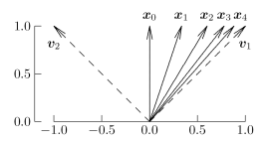

Geometric interpretations
Repeated multiplication by A causes component in $v_{1}$ (corresponding to larger eigenvalue) to dominate, so sequence of vectors $x_{k}$ converges to $v_{1}$.

Slide 8
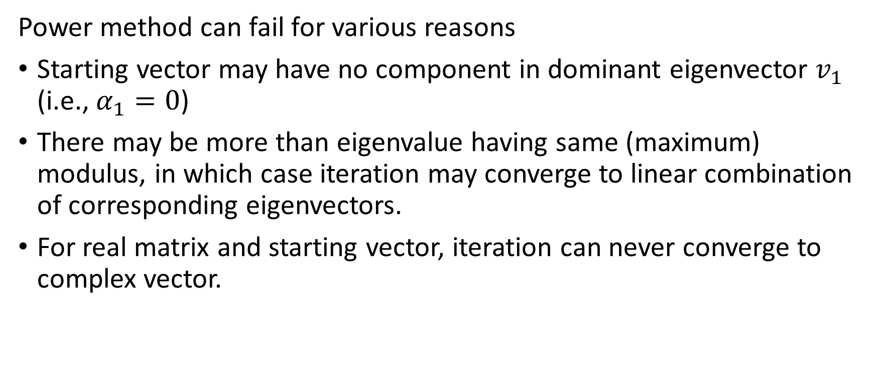
Limitations of Power Method
Power method can fail for various reasons
Starting vector may have no component in dominant eigenvector $v_{1}$ (i.e., $α_{1}=0$)
There may be more than eigenvalue having same (maximum) modulus, in which case iteration may converge to linear combination of corresponding eigenvectors.
For real matrix and starting vector, iteration can never converge to complex vector.

Slide 9
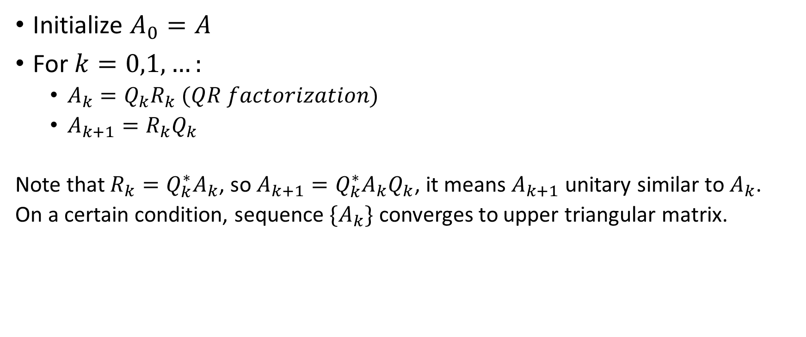
QR Method
Initialize $A_{0}=A$
For $k=0,1,…:$
$A_{k}=Q_{k}R_{k} (QR factorization)$
$A_{k+1}=R_{k}Q_{k}$
Note that $R_{k}=Q_{k}^{∗}A_{k}$, so $A_{k+1}=Q_{k}^{∗}A_{k}Q_{k}$, it means $A_{k+1}$ unitary similar to $A_{k}$.
On a certain condition, sequence $\{A_{k}\}$ converges to upper triangular matrix.

Slide 10
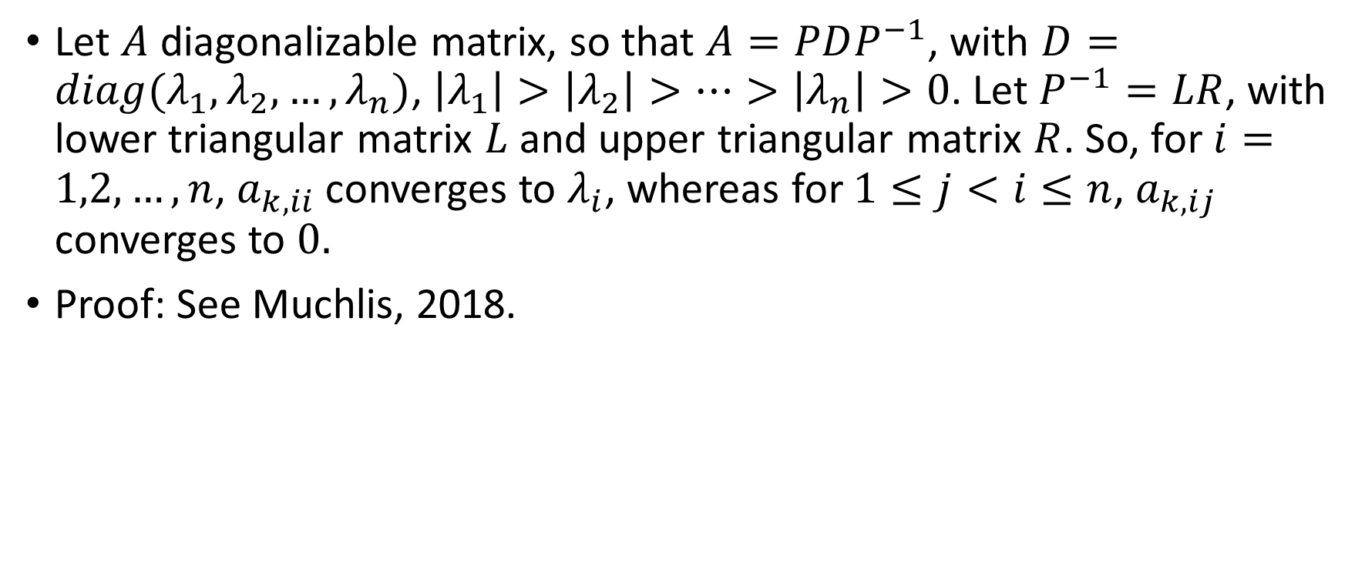
Theorem
Let $A$ diagonalizable matrix, so that $A=PDP^{−1}$, with $D=diag(λ_{1},λ_{2},…,λ_{n})$, $\left|λ_{1}\right|>\left|λ_{2}\right|>…>\left|λ_{n}\right|>0$. Let $P^{−1}=LR$, with lower triangular matrix $L$ and upper triangular matrix $R$. So, for $i=1,2,…,n$, $a_{k,ii}$ converges to $λ_{i}$, whereas for $1≤j<i≤n$, $a_{k,ij}$ converges to $0.$
Proof: See Muchlis, 2018.

Slide 11
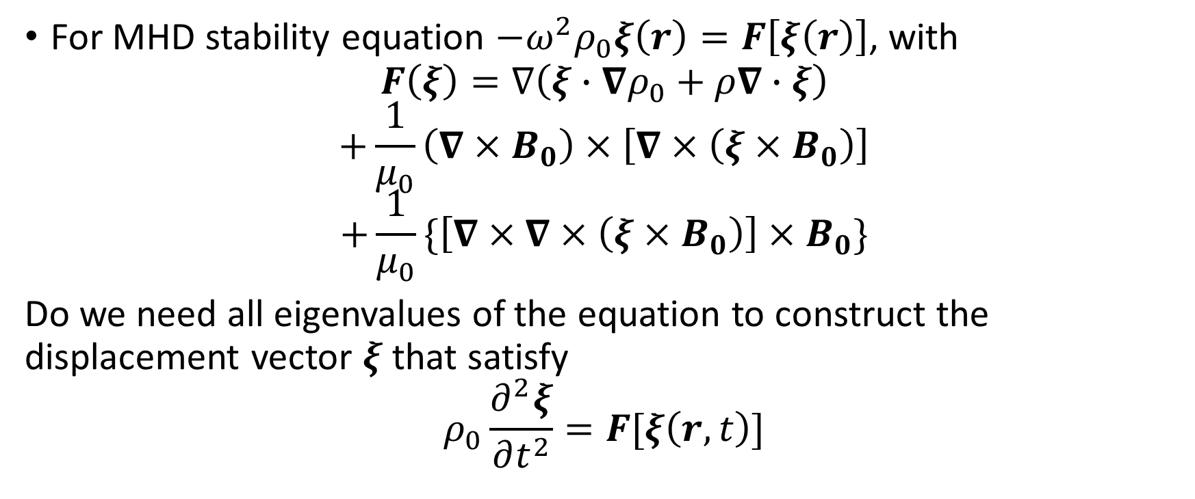
Questions
For MHD stability equation $−ω^{2}ρ_{0}ξ\left(r\right)=F\left[ξ\left(r\right)\right]$, with
$$F\left(ξ\right)=∇\left(ξ∙∇ρ_{0}+ρ∇∙ξ\right)$$
$$+\frac{1}{μ_{0}}\left(∇×B_{0}\right)×\left[∇×\left(ξ×B_{0}\right)\right]$$
$$+\frac{1}{μ_{0}}\{\left[∇×∇×\left(ξ×B_{0}\right)\right]×B_{0}\}$$
Do we need all eigenvalues of the equation to construct the displacement vector $ξ$ that satisfy
$$ρ_{0}\frac{∂^{2}ξ}{∂t^{2}}=F[ξ\left(r,t\right)]$$

Slide 12

Questions
Do we need to find the equilibrium of density and magnetic field, $ρ_{0}$ and $B_{0}$?

Slide 13

Questions
From finite difference approximation, we can have $n$ eigenvalues and eigenvectors, whereas the eigenvalues of the differential equation possibly infinite.

Slide 14
Questions
Boundary condition for the displacement vector in plasma dynamics within torus?
Is it possible eigenvalue problem for initial value problem?

Slide 15
Questions
Is the initial value formulation better than normal mode formulation to determine the time-evolution of displacement vector?

